Slide 1
TELEGRAM
COSMETICS-CHECKBOT

Slide 2
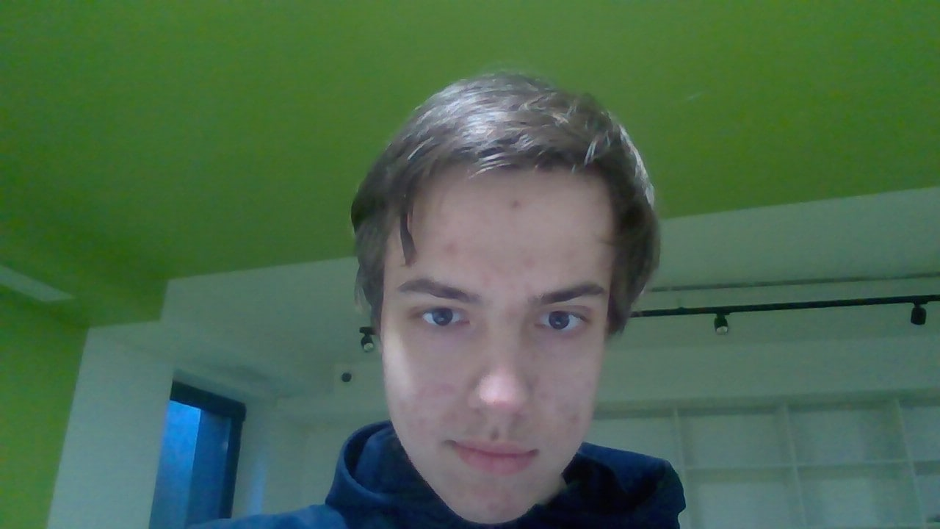
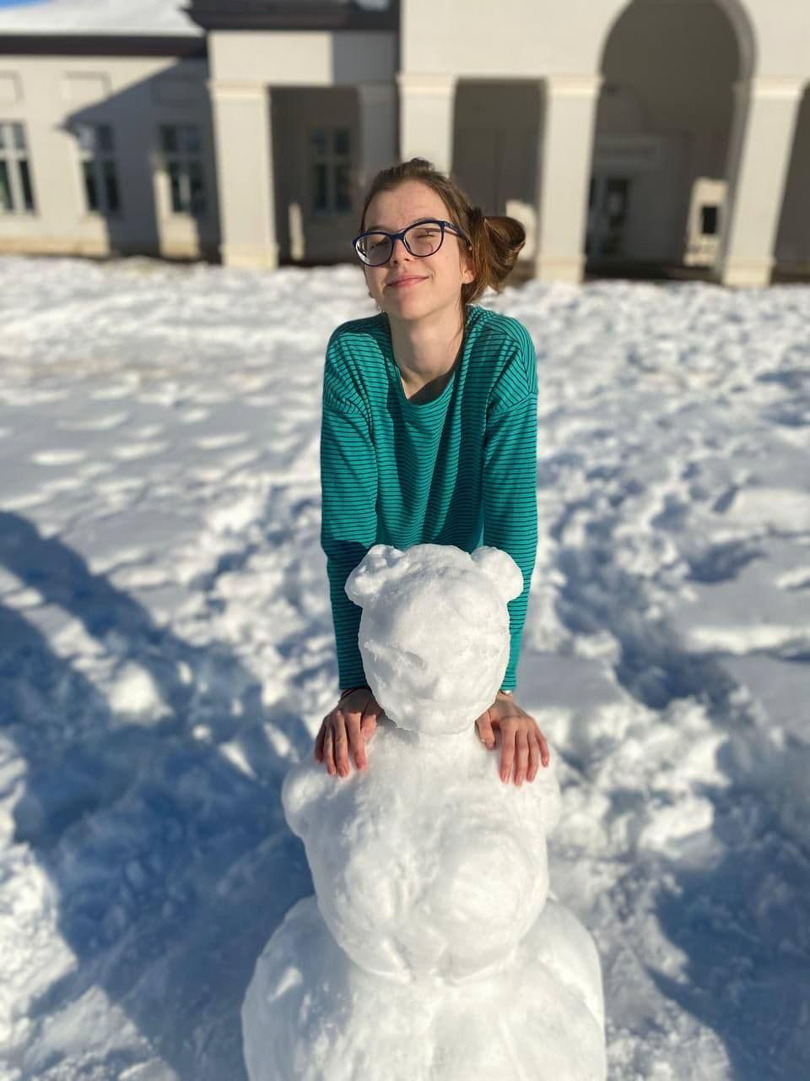
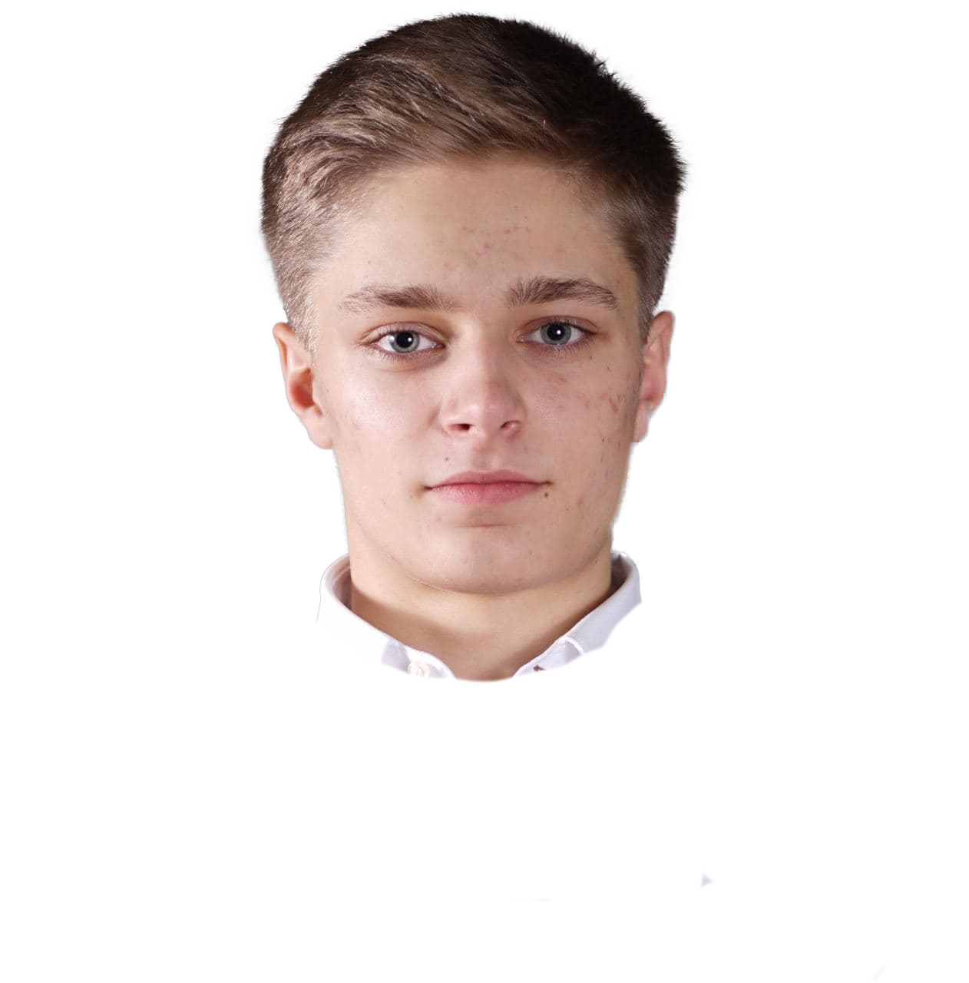
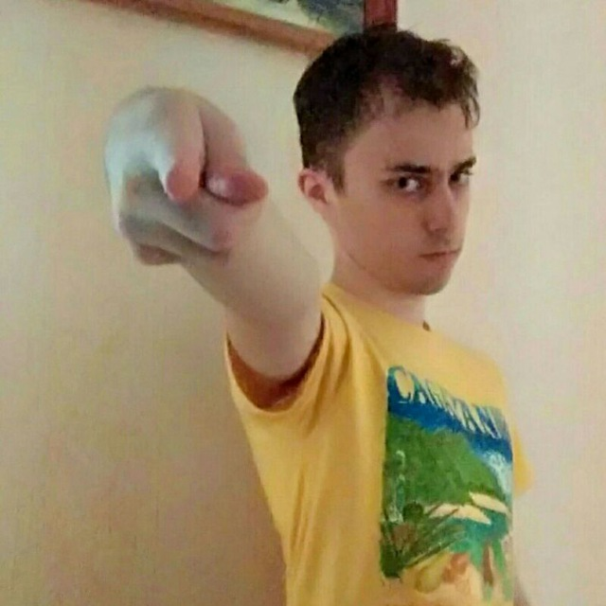
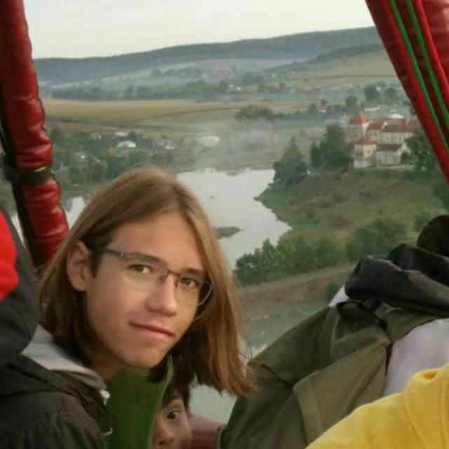
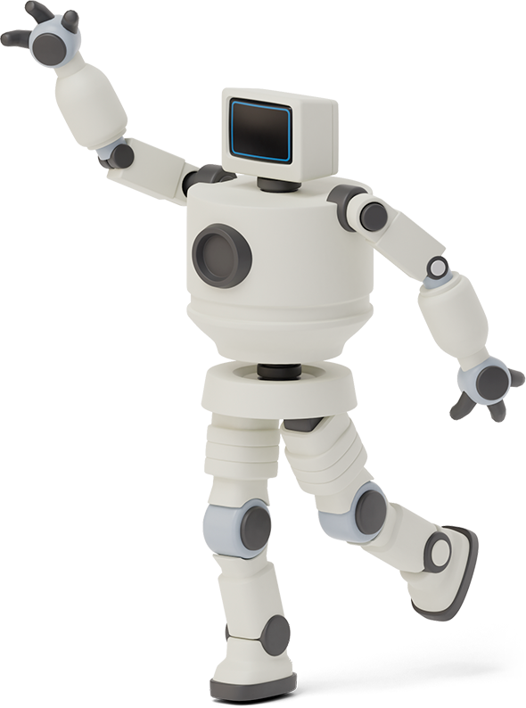

Our team
Ярослав Бровченко
Роман Кипибіда
Дар’я Шабацька
Олександр Рига
Петро Гентош

Slide 3
1. Актуальність
Чи потребують люди цей продукт та чи будуть ним користуватись?

Slide 4
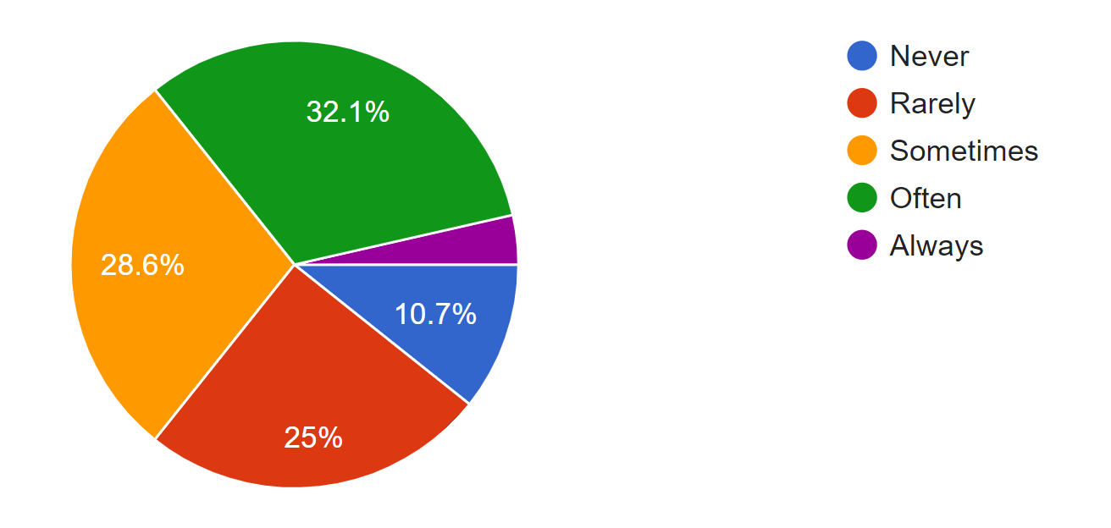
How often do you check composition of the cosmetics you buy?

Slide 5
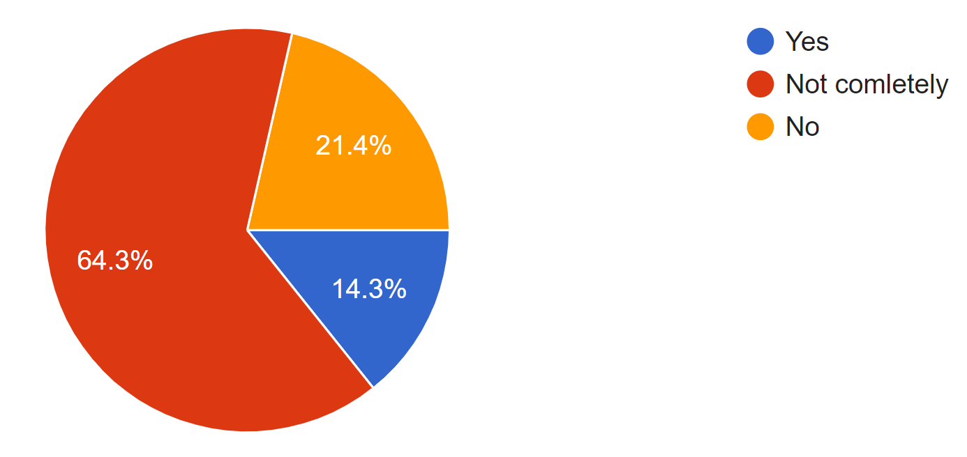
Do you think you have enough information about the safety of your product?

Slide 6
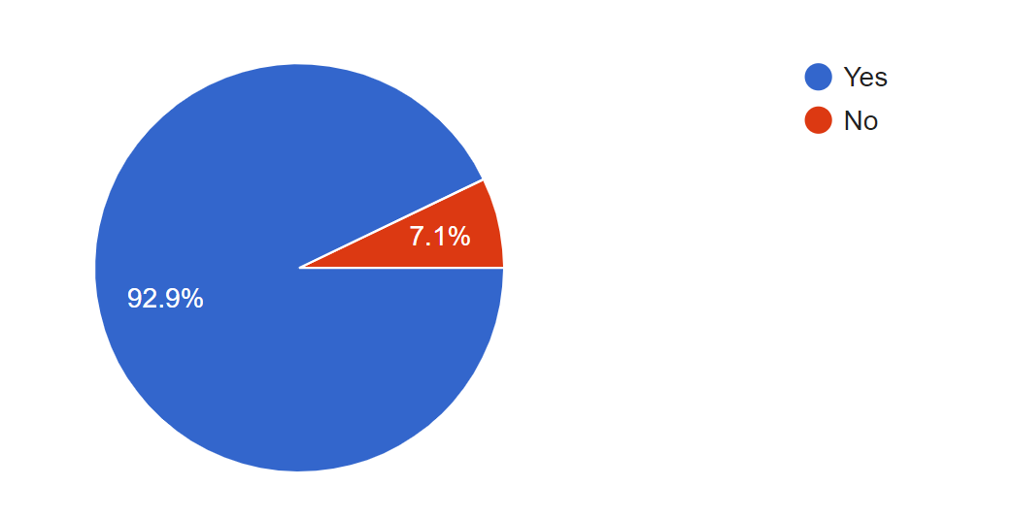
If there was an application to control the safety of your self-care products, would you use it?

Slide 7
Наша
мета
Зробити доступною перевірку складу та захистити здоров’я наших користувачів!

Slide 8
2. Реалізація
Як зробити зручний та простий у використанні продукт?

Slide 9
Built With
Telegram API
This API allows to connect bots to Telegram system. Telegram Bots serve as an interface for code running somewhere on your server.
GOOGLE-Cloud-Vision
pre-trained Vision API models to detect emotion, understand text, and more.

Slide 10
Our process is easy
Send the photo of ingredients
Get the info about restricted ones
Get the overall info
1
2
3

Slide 11
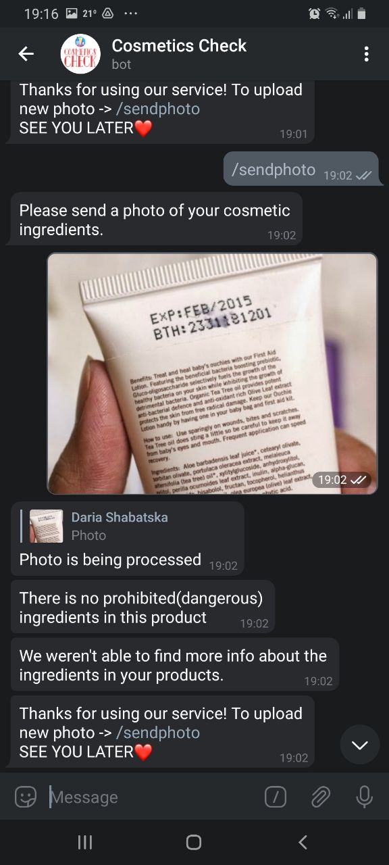
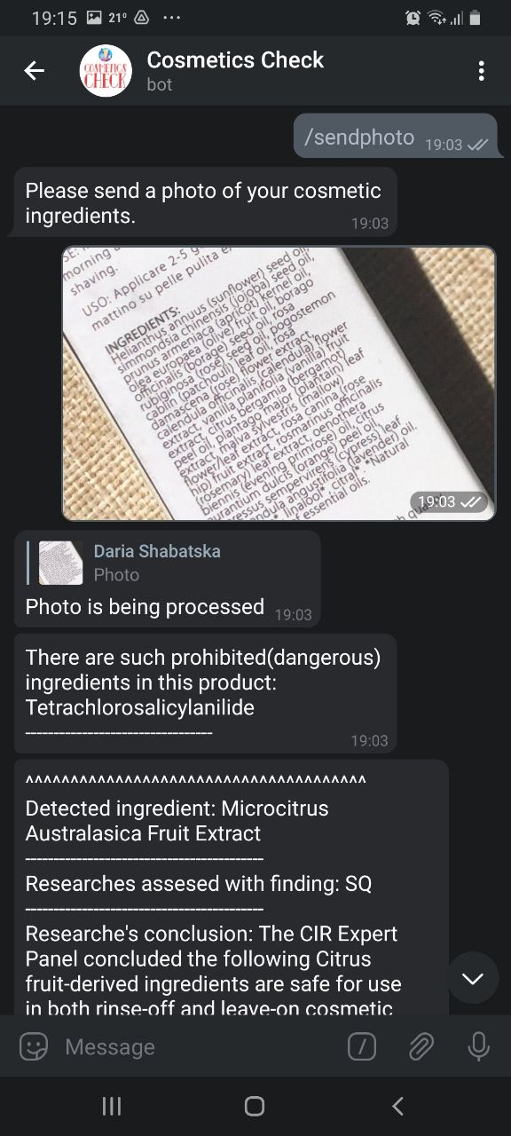
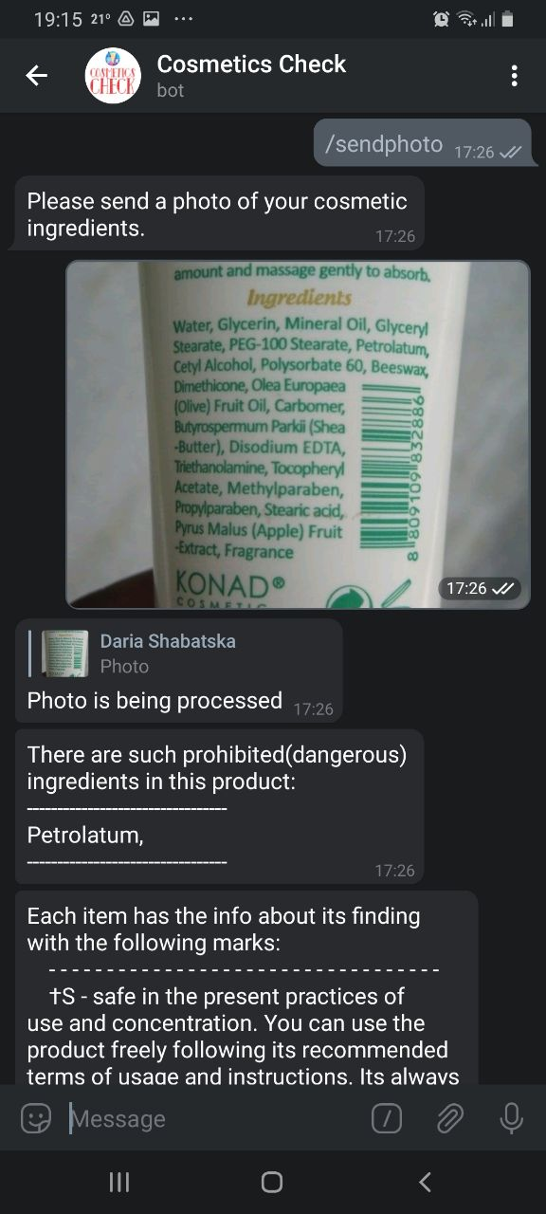

Slide 12
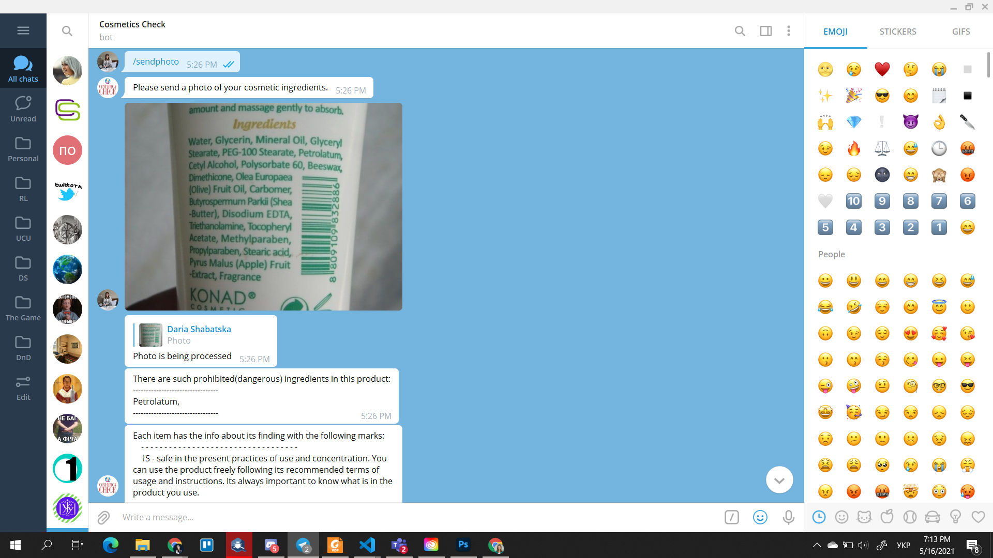

Slide 13
89,526,124
Whoa! That’s a big number, aren’t you proud?

Slide 14
Дякую!
Є питання?

Slide 15
This is a slide title
Here you have a list of items
And some text
But remember not to overload your slides with content
Your audience will listen to you or read the content, but won’t do both.

Slide 16
In two or three columns
Yellow
Is the color of gold, butter and ripe lemons. In the spectrum of visible light, yellow is found between green and orange.
Blue
Is the colour of the clear sky and the deep sea. It is located between violet and green on the optical spectrum.
Red
Is the color of blood, and because of this it has historically been associated with sacrifice, danger and courage.

Slide 17
89,526,124$
185,244 users
100%
That’s a lot of money
And a lot of users
Total success!

Slide 18
Let’s review some concepts
Yellow
Is the color of gold, butter and ripe lemons. In the spectrum of visible light, yellow is found between green and orange.
Blue
Is the colour of the clear sky and the deep sea. It is located between violet and green on the optical spectrum.
Red
Is the color of blood, and because of this it has historically been associated with sacrifice, danger and courage.
Yellow
Is the color of gold, butter and ripe lemons. In the spectrum of visible light, yellow is found between green and orange.
Blue
Is the colour of the clear sky and the deep sea. It is located between violet and green on the optical spectrum.
Red
Is the color of blood, and because of this it has historically been associated with sacrifice, danger and courage.

Slide 19
Presentation design
This presentation uses the following typographies:
Titles: Ubuntu Bold
Body copy: Ubuntu Light
Download for free at: https://design.ubuntu.com/font/
You don’t need to keep this slide in your presentation. It’s only here to serve you as a design guide if you need to create new slides or download the fonts to edit the presentation in PowerPoint®

Slide 20
2. Extra Resources
For Business Plans, Marketing Plans, Project Proposals, Lessons, etc

Slide 21
Roadmap
Blue is the colour of the clear sky and the deep sea
Red is the colour of danger and courage
Black is the color of ebony and of outer space
1
3
5
2
4
6
Yellow is the color of gold, butter and ripe lemons
White is the color of milk and fresh snow
Blue is the colour of the clear sky and the deep sea

Slide 22
Funnel
AWARENESS
Insert your content
DISCOVERY
Insert your content
EVALUATION
Insert your content
INTENT
Insert your content
PURCHASE
Insert your content
LOYALTY
Insert your content

Slide 23
SlidesCarnival icons are editable shapes. This means that you can:
Resize them without losing quality.
Change fill color and opacity.
Change line color, width and style.
Isn’t that nice? :) Examples:
Find more icons at slidescarnival.com/extra-free-resources-icons-and-maps

Slide 24
Diagrams and infographics

